Slide 1

KATIHAR ENGINEERING COLLEGE, KATIHAR
HUMANOID – A SERVICING ROBOT
KATIHAR ENGINEERING COLLEGE, KATIHAR - 854109
AFFILIATED TO ARYABHATTA KNOWLEDGE UNIVERSITY, PATNA,
BIHAR (INDIA) APRIL-2022
Submitted by: Under the guidance of:
Navin Kumar (18105129041) Asst. Prof. Shritosh Kumar
Preeti Kumari (18105129026)
Nisha Verma (18105129024)

Slide 2
CONTENTS
INTRODUCTION
WEEK PLAN
HARDWARE REQUIREMENTS
SOFTWARE REQUIREMENTS
DESIGN
ROBOT WORKING PRINCIPLE
APPLICATION
ADVANTAGES
DISADVANTAGES
RESULT
CONCLUSION
REFERENCES

Slide 3
INTRODUCTION
In This Robot We Show controlling by wireless for serving food and medicine , So this robot can serve anything without human support , we can stay our chair and control by mobile and give command and he follow that command and do that work .
In this robot we show automatic hand sanitizer when any one come for taking food that time he can sanitize his hand with our touch any think .
Our robot help for area like if we want to serve medicine in hospital and there are covid patient and we don't want to go on there then we can use this robot on there for service medicine and food .

Slide 4
WEEK PLAN
WEEK | PLAN
Week 1 | Study about the mechanism of components used in this project.
Week 2 | Learn about Arduino IDE environment and basics of its programming.
Week 3 | Work on Humanoid Robot mechanism of model and lower part connection.
Week 4 | Work on middle part , Bluetooth speaker and automatic hand sanitizer connection of humanoid Robot model .
Week 5 | Integrate Robot models and code for it.
Week 6 | Work on upload the code in Arduino IDE.
Week 7 | Work on design body part for humanoid servicing robot.
Week 8 | Code for the desired output generation of the model and feed it into the system.
Week 9 | Testing phase of the model and debugging.
Week 10 | Debugging if any and prepare reports and present.

Slide 5
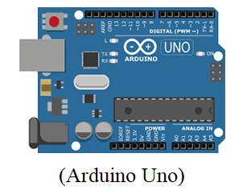
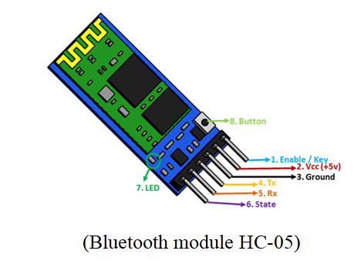
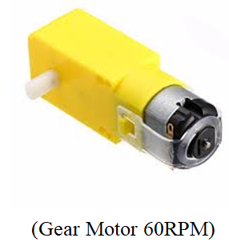
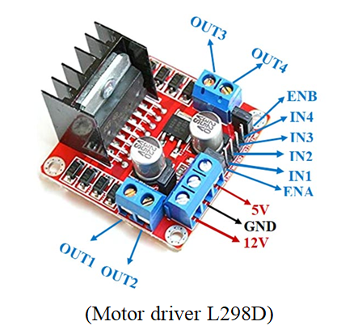
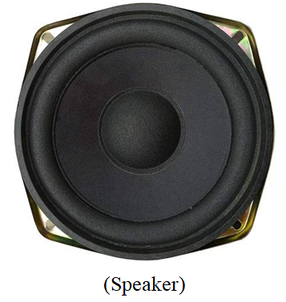
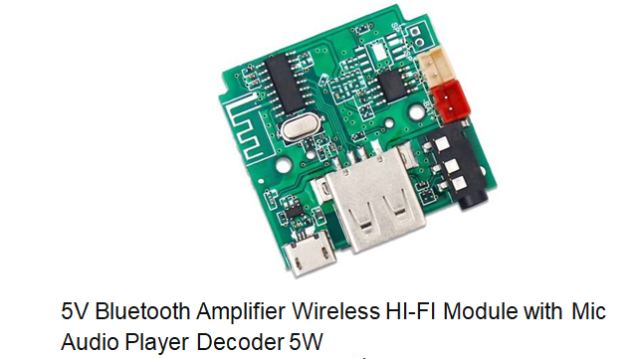
Hardware Requirements

Slide 6
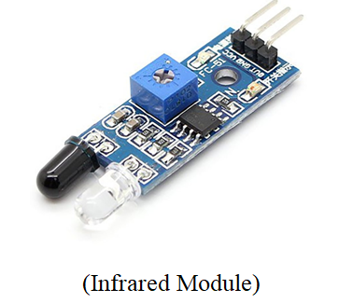
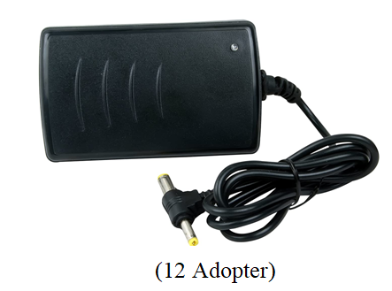
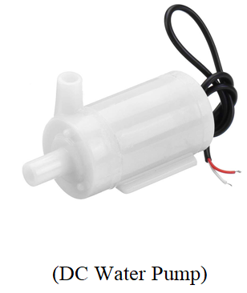
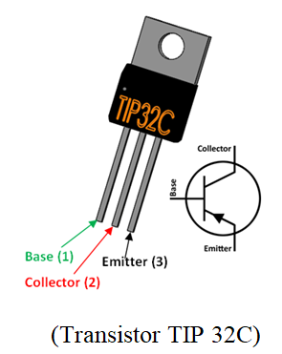
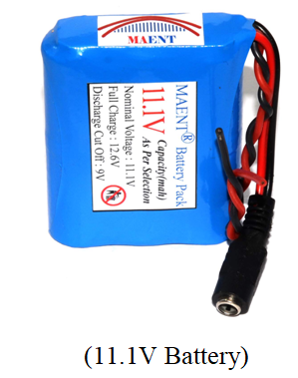
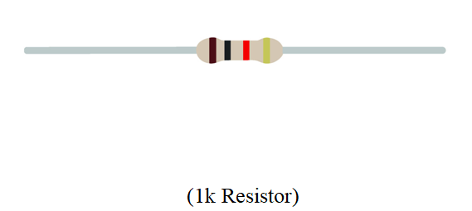
Cont…

Slide 7
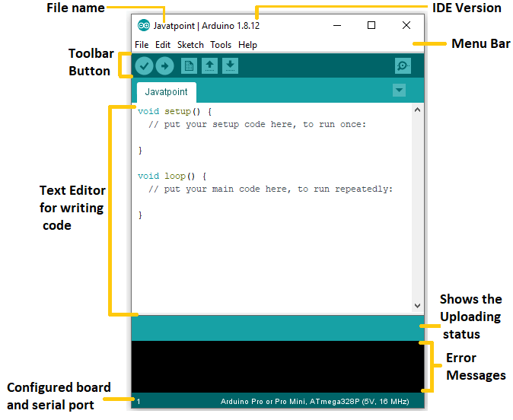
Software Requirements
1. Arduino IDE

Slide 8
Cont…
2. Android APP
Android is an open-source operating system which means that any manufacturer can use it in their
phones free of charge. It was built to be truly open. Android is built on the open Linux Kernel.
Furthermore, it utilizes a custom JAVA virtual machine.
Download apps from Google Play
Open Google Play.
On your phone, use the Play Store app.
Find an app you want.
To check that the app is reliable, find out what other people say about it.
When you pick an app, tap Install (for no-charge app).

Slide 9
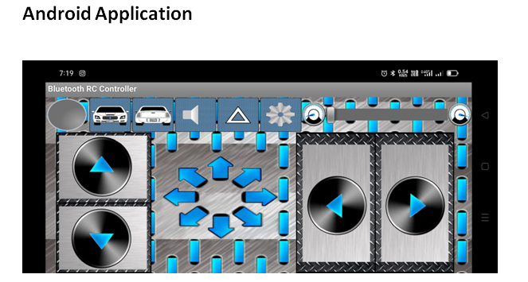
Cont…..

Slide 10
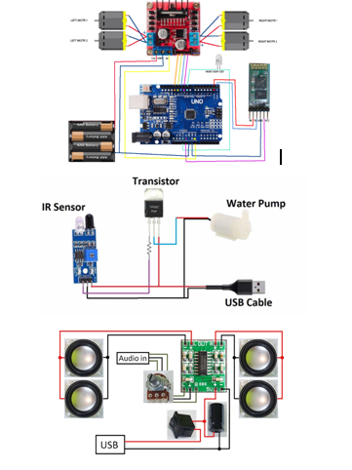
DESIGN

Slide 11
ROBOT WORKING PRINCIPLE
A servicing Robot is based on IOT.
Arduino are connected with the input1, input2, input3 and input4 of the motor drive.
Motors are connected to the either sides of Motor Drive which are the outputs terminals.
Transistor logic pins, Transmitter (TX) and Receiver (RX) of Arduino UNO are connected to RXD and TXD of Bluetooth HC-05 respectively.
The program is uploaded to Arduino before connecting the Bluetooth module.
IR proximity sensor detects the presence of a hand and makes the OUT pin LOW.
Bluetooth module and speaker we Connected Bluetooth module to speaker directly and give Arduino Battery power to Bluetooth module and open our mobile app and connected to Bluetooth and type the SMS and press the speaker button and sound make the sound of that SMS.

Slide 12
APPLICATIONS
Low range Mobile Surveillance Devices
Military Applications (no human intervention)
Assistive devices (like wheelchairs)
Home automation

Slide 13
ADVANTAGES
It can move in all 8 directions i.e., in 360 degrees.
Robots can work in factories , Hospital, School & Colleges.
This robot is serve food or products, to carry material from one place to another, to send medicines to the patients kept in the isolated environments etc.

Slide 14
DISADVANTAGES
Results from humanoid robots will be that many people are going to lose their jobs.
They need constant power.
The perform relatively few tasks.
They have no emotions.
They impacts human interaction.
They're expensive to install and run.

Slide 15
CONCLUSION
IOT or internet of things is the very important part in both computer and our daily lives.
We also tested the applications used to food servicing robot .
Due to the new concept of Wireless Controlled robot using Bluetooth, Wi-Fi and IOT, In A Future we use this type of robot in our life for servicing food and for other work , so our project successful and its working amazing so our conclusion is good after complete our project .

Slide 16
References
[1] https://compoindia.com (Last accessed: 15/06/2022)
[2] https://www.arduino.cc/en/software (Last accessed: 10/07/2022)
[3] https://www.shutterstock.com/search/car+drawing
(Last accessed: 15/07/2022)
[4] https://www.instructables.com/Smartphone-Controlled-RC-Car-Using-Arduino (Last accessed: 13/07/2022)

Slide 17
THANK YOU☺!
Have a nice day.

